Slide 1

Gap Inc.
IBM Proposal for the
E.piphany Relocation Project
E.piphany Relocation Discussion
September 26, 2003

Slide 2
Agenda
8:00 – 9:00 am | Introductions, IBM’s Relevant Experience
9:00 – 9:15 am | Break
9:15 – 10:45 am | Solution Overview, IBM Approach to Project
10:45 – 12:15 am | Customer ODS Review and Discussion
12:15 – 1:00 pm | Lunch
1:00 – 1:45 pm | E.piphany Review and Discussion
1:45 – 2:00 pm | Break
2:00 – 4:00 pm | Hosting, Infrastructure and Support Review and Discussion
4:00 – 5:00 pm | Wrap-Up and Q&A
Today’s Objectives:
  Walk through the proposed solution
  Provide opportunity for clarification
  Forum to meet and interact with the IBM team

Slide 3
Introductions
IBM Participants
Alex Hart – IBM Client Manager for The Gap
Dana Klebes – Client Services Executive for The Gap
Maxine Levy – Project Partner
Patience Hering – Project Manager
Cass Squire – Solution Architect
Sandy Emerson – Application Architect
David Dul – Data Modeler
Gil Valera – E.piphany
Warren King – E.piphany
Mark Jacobs – CRM / Retail Advisor
Brian Finerman – Hosting Executive
Markus Lenger – Hosting Technical Solutions Manager
Sheryl Cipolla – Application Management Support Services

Slide 4
Practice Overview
IBM’s Relevant Experience
Business Consulting Services
  A recognized global marketplace leader – world’s largest and most experience business intelligence consulting practice
  Designed and implemented some of the world’s largest and most complex business intelligent solutions
  Proven industry-focused solutions with accelerators for rapid delivery
  Strategic partnerships with industry-leading providers of complementary solutions
  Industry-experienced consultants delivering tailored solutions collaboratively with client teams
e-Business Hosting and Application Support Services
  A recognized global marketplace leader – ranked #1 by Gartner Inc., Meta Group, and Tier 1 Research
  Leading the transition to On Demand Flexible Hosting solutions and offerings
  Provides the full continuum of services from infrastructure to full application support and management
  Currently providing fully managed server, infrastructure, and hosting services for more than 6,000 customers worldwide with over 100,000 servers under management in 175 IBM data center facilities worldwide
  IBM Global Services is the largest provider of application-related outsourcing services in the world with more than 32,000 AMS professionals in 30 countries, including major delivery capabilities in the US, Canada, Mexico, Brazil, UK, Netherlands, Germany, France, Italy, Japan, India, and Australia

Slide 5

































IBM’s Partner / Alliance Network
IBM’s Relevant Experience
Key alliances leveraged for the E.piphany Relocation Project

Slide 6
IBM’s Relevant Experience
Fortune 50 Multi-Channel Retailer
Selected Case Study #1
Application Type: Enterprise Customer File Project Timeframe: 1999-2001
Size/Environment: >50 terabytes running on IBM MVS, DB2, MQ Series
Client Situation: Client envisioned a centralized view of the customer as part of a strategy to improve the multi-channel customer experience and streamline retail business processes. An enterprise customer database was created to serve as the customer system of record for retail, internet and catalog.
Application Highlights:
  The integrated customer information file is the foundation for CRM efforts at client. It is used by frontline applications (e.g. call centers, internet) interact with the warehouse as the master source of customers. It is the source for direct campaign (catalog, internet and retail) analytics.
  Ability to integrate with multiple applications with different technical frameworks (internet store, call center customer recognition, mainframe).
  Multi-channel customer warehouse:
Types of Information
Purchases: catalog, internet, retail
Customer Profile: phone, email, etc.
Privacy: Opt-in/out, add to mail list, etc.
Scoring & Demographics: value, segments
Retail Statistics
Total Names > 190 Million
3 Year Active > 60 Million
Catalog/Internet Statistics
Total Names > 70 Million
3 Year Active > 40 Million
Internet
Catalog
Call Center
Retail POS
Matches
Customer
ODS
Campaign Mgt (CERES)
Analytics (SAS)

Slide 7
IBM’s Relevant Experience
Fortune 50 Multi-Channel Retailer
Selected Case Study #1 (cont.)
Key Issue: Hygiene is the single most important activity occurring in the warehouse. The “cost” of bad/unmailable addresses can be substantial:
Catalog/Internet:
The total mailing cost associated with bad addresses was > $4 million per year.
Retail:
Every non-mailable Retail address results in >$60 incremental lost sales annually.
Modeling for Retail prospects delivered incremental sales >$100 million – it is dependent on accurate identification and purchase history.
Hygiene Efforts:
Hygiene Processes Frequency Comments
Address Standardization
With any address updates / changes
Process takes place with any name/address from the customer update/change or any other source.
Every 2 Weeks
Trillium software
Internal NCOA
Every 2 Weeks
Internal NCOA is from returned mail
External NCOA
Quarterly
NCOA uses information from the US Postal Service Files
NSA/Do Not Mail Identification / Advanced Address Correction
Every 2 weeks
Identify addresses from the ongoing NCOA process that may be a potential problem for Book delivery
Phone Edits
With each customer update
Identify bad or potentially bad phone #’s at the time of update
Area Code Maintenance
Monthly
Update area code changes as they occur, useful for better matching, surveys and contact

Slide 8
IBM’s Relevant Experience
Major Internet / Media Provider
Selected Case Study #2
Application Type: Business Intelligence/Analytics Project Timeframe: 2002 - ongoing
Client Situation:
Client’s market has shifted from millions of potential dial-up (narrowband) prospects to an environment (in the US) where the market is fairly saturated
Broadband (Cable & DSL) is the wave of the future
They must completely re-focus their marketing from purely acquisition focused to shift to a retain, cross-sell, up-sell model
They have no analytics to support marketing strategy
Hired IBM to help them build a Data Warehouse and BI environment
Application Highlights:
The business intelligence/analytics platform integrates data from multiple different external sources
Contains information on demographics, contacts, billing, usage etc..
Customer matching, de-duping, address scrubbing are performed before loading into main DW / ODS environment
Reporting and analytic toolsets include Business Objects, SAS and SPSS
Key Customer Volumes :
  28 million current customers
  400 million daily emails
  3.5 TB – daily feed into the warehouse

Slide 9
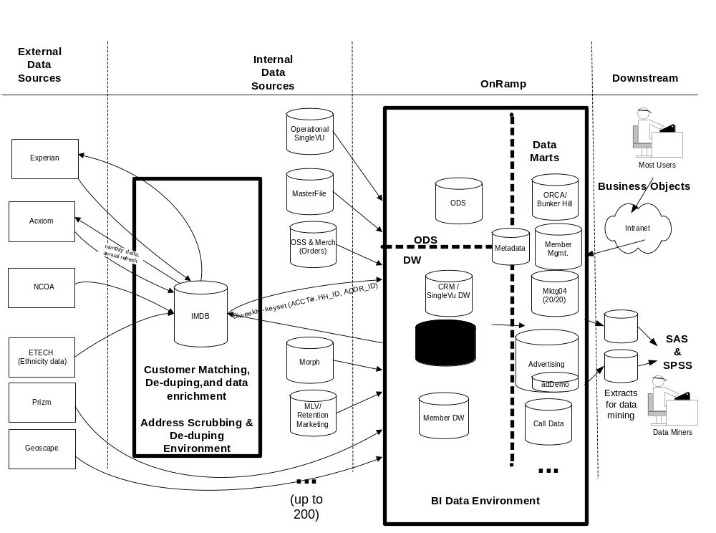
IBM’s Relevant Experience
Major Internet / Media Provider
Selected Case Study #2
New Customer Data Warehouse / BI Environment

Slide 10
IBM’s Relevant Experience
Cendant
Selected Case Study #3
Application Type: Vacation ownership company, E.piphany Analytics and Campaign Management – Migration from E.5 to E.6,Hosting, Outsourcing
Size/Environment: Current - 20 million individuals (expanding database to 500 – 700
Client Situation:
Customer uses E.piphany Campaign Management to generate direct mail campaigns. Original implementation was about on E.5 two years ago using multiple mid-tier E.piphany partners
Customer wanted to migrate from E.piphany E.5 on DB2 to E.piphany E.6 on Oracle 9i and selected E.piphany EKG to perform the migration.
Features of E.6 leveraged: generalized demographics and seeding features of E.6.
Approach involved : Migrating key data from DB2 to Oracle 9i, initial load and revalidation of the E.piphany data mart, migrating campaign history data to E.6 EpiOp and then ran backfeed to populate campaign history in the E.6 Data Mart
Hosting and Support
IBM has a 10 year outsourcing contract with Cendant Corp. to provide a broad range of IT services to Cendant’s 40 business units in five industries.
IBM Global Services provides all infrastructure, systems management, and application support services for the mid range environment which includes E.piphany
IBM Global Services manages all of Cendant’s data center operations and supports all of their subsidiaries including managing Cendant’s Web sites, Web-based services and hosting Cendant’s online information processing for Wiz.com, TRIP.COM and Cheap Tickets.com.

Slide 11
IBM’s Relevant Experience
J.P. Morgan Chase & Co.
Selected Case Study #4
Application Type: Large Scale Hosting Project Timeframe: 2002 - ongoing
Client Situation:
For J. P. Morgan Chase a world-class technology infrastructure was a key competitive advantage. However, in an evolving market, the complexity of managing that infrastructure -- and the associated costs -- could slow continued growth.
The company needed to transform their business model in order to increase focus on customer needs and business lines, improve service levels, increase capacity for greater responsiveness and move to a variable cost structure
Application Highlights:
J. P. Morgan Chase elected IBM’s On Demand service for a significant portion of its technology infrastructure.
Instead of a traditional fixed-cost approach, the bank is working with IBM Global Services to create a virtual pool of computing resources that can be accessed, deployed and paid for on an as-needed basis.
The solution is based on IBM’s Universal Management Infrastructure (U.M.I.), a set of open standard-based components that enable IT services to be managed as utilities, reducing costs and improving efficiencies.
There are immediate, significant economic benefits possible through a variable, “pay-for-what-you-use” cost structure.
The company will receive a continuous infusion of technology and business process innovations from IBM, supporting efficient growth and accelerating the pace of innovation.
IBM’s U.M.I technology will enhance the availability, reliability and security of the IT infrastructure.

Slide 12
The Gap Inc. E.piphany Relocation Discussion
Solution Overview
Introductions, IBM’s Relevant Experience
Solution Overview
IBM Approach (Project Approach, Timeline)
Customer ODS Review and Discussion
E.piphany Review and Discussion
Hosting, Infrastructure and Support Review and Discussion
Wrap-Up and Q&A

Slide 13
Summary Solution Overview
Solution Overview
Build and Implement the Customer ODS and E.piphany V6 Campaign Management
  Project Management
  Implementation of ETL from multiple sources
  Implementation of Trillium Scripts for customer hygiene and de-duplication
  Implementation of job scheduling
  Testing of the solution (unit, system, conversion, integration, performance, user acceptance)
  Migration to production
Provide infrastructure to support implementation of development, QA and production
  Hardware
  Software
  Network
Hosting, Maintenance & Support
  Infrastructure support
  Application support

Slide 14
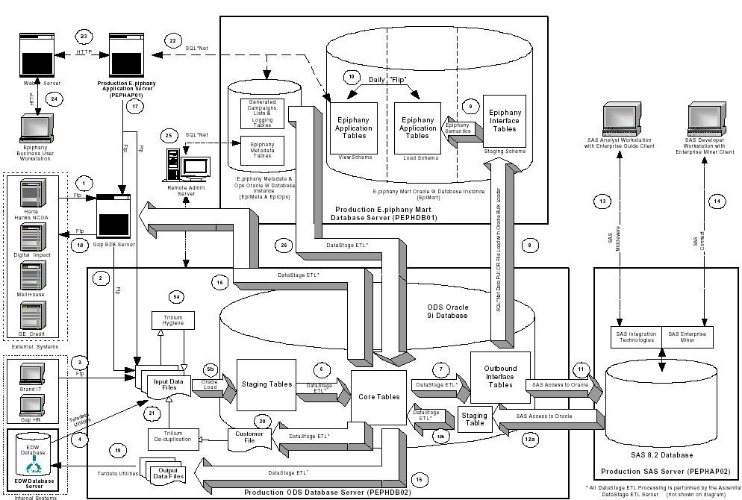
Logical Architecture of the Gap E.piphany Relocation
Solution Overview
IBM supports this architecture and tool set from a conceptual level and will validate the design fully in the Design Confirmation phase of the project.

Slide 15
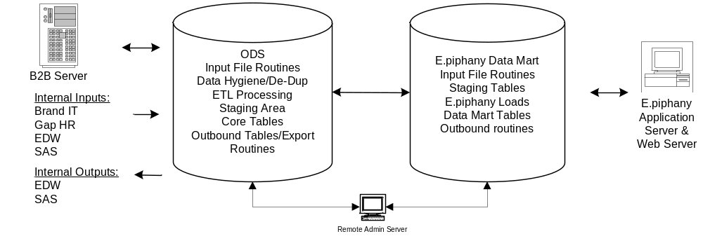
Proposed IBM Development Scope
Solution Overview
Based upon the ODS/E.piphany RFP, we have created a high level diagram that depicts the IBM scope required for this project.
Using this high level diagram, a physical architecture was created to support this application from development through deployment.

Slide 16
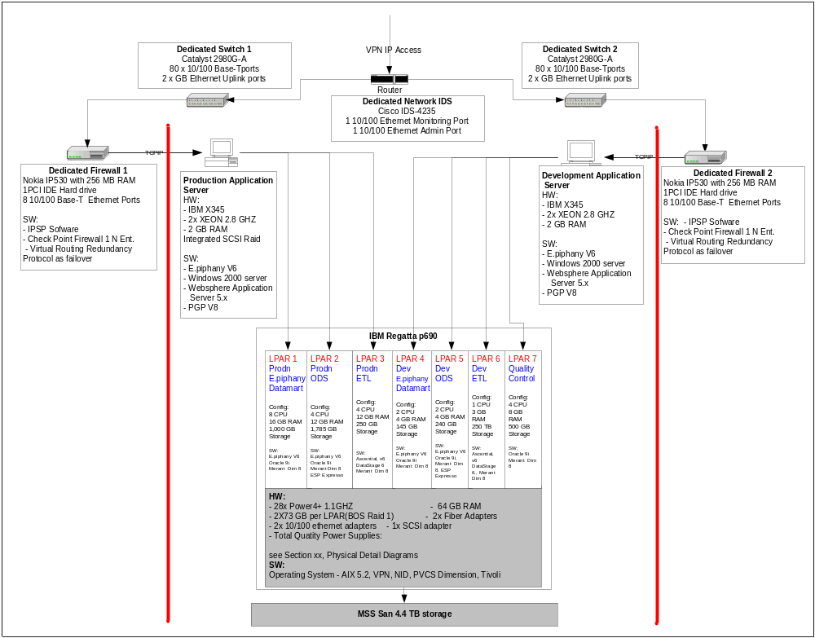
Proposed Physical Architecture
Solution Overview
Secure VPN connectivity
The E.piphany development and production environments will be host on dedicated xSeries servers.
IBM is proposing a P690 with seven Partitions to Host the ODS Development and Production environments.

Slide 17
Hosting Services Summary
Solution Overview
  Managed Server Support
    OS Systems Administration and Real-Time Monitoring of all LPAR instances and servers
    Ping Monitoring
    Virus Protection
    Process Monitoring
    Threshold Monitoring
    Database Monitoring
    Server Resource Monitoring for Historical Performance/Capacity Planning
  Network Connectivity
    Managed High Availability VPN
    Committed Information Rate of 3 Mbps with redundant 10Mbp internet connection
    Managed High Availability Cisco Switches
    Managed Network Intrusion Detection Services
  Managed Storage Services
    Back up and Restore services using Tivoli Storage Manager
  Acceptance Testing Support for Infrastructure
  Transaction Availability Monitoring – End to End Script Running/Maintenance

Slide 18
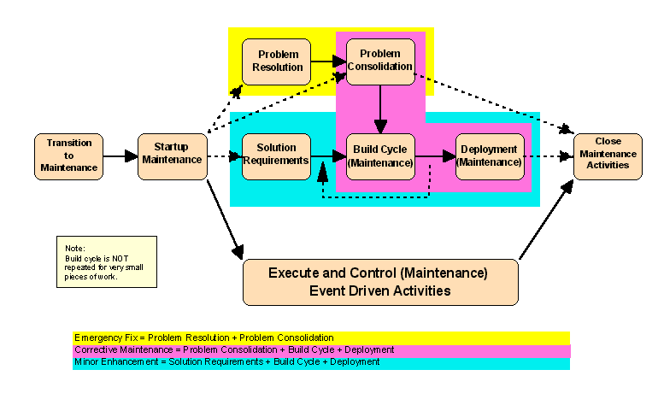
Support and Maintenance Summary
Solution Overview
The IBM Application Management Services team will provide on-going Application Support, Maintenance and Small Enhancements for 30 months following Go Live.

Slide 19
The Gap Inc. E.piphany Relocation Discussion
IBM Approach
Introductions, IBM’s Relevant Experience
Solution Overview
IBM Approach (Project Approach, Timeline)
Customer ODS Review and Discussion
E.piphany Review and Discussion
Hosting, Infrastructure and Support Review and Discussion
Wrap-Up and Q&A

Slide 20
Project Approach and Key Milestones
IBM Approach
11/03
7/04
12/06
ODS / E.6 Implementation
Design
Build
Deployment
Infrastructure Deployment
Build
Dev
Build QA &
Production
Support & Maintenance Activities
Transition
Planning
Transition
Steady State

Slide 21
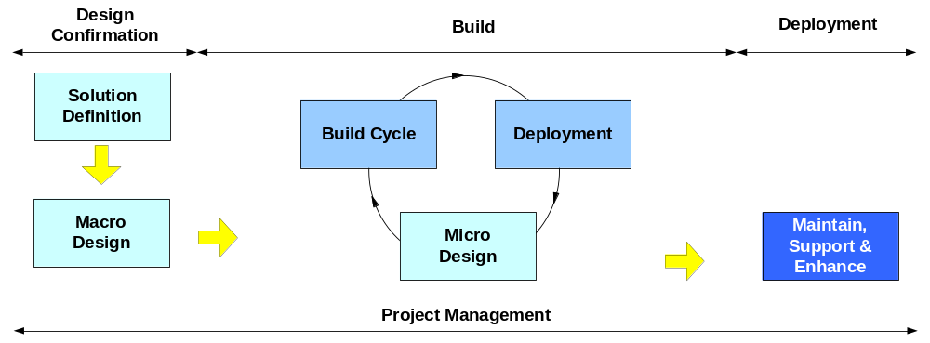
Custom Development Engagement Model
IBM Approach
The IBM Custom Development Engagement Model will be used to guide the Gap E.piphany relocation project
Design Confirmation Components
Project Start-up
Review Macro Design Infrastructure /Architecture
Review Micro Design
Refine Detail
Build Plan
Build Components
Develop Master Test Plan
Establish QA & Development Environments
Code Interfaces & Programs
Migrate
Execute Test
Deployment Components
Establish Production Environment
Prepare for Production Cutover
Cutover to Production
On going Support and Maintenance

Slide 22
Design Confirmation Approach
IBM Approach
Review
Macro Design Infrastructure /Architecture
Review
Micro
Design
Consolidate
Gaps and
Resolution
Approach
Project
Start-up
Refine Detail
Build Plan
Key Activities
Develop project plan
Establish joint project team
Schedule interviews / meetings for review
Reconcile methodologies
Prepare Kick-off
Review Architecture documentation
Conduct design review meetings
- System Arch
- Data Flow Arch
Encryption Arch
Batch Job Arch
Unix Job Arch
E.piphany Arch
Validate design meets requirements
Identify areas for improvement and gaps
Updated Architecture Docs
Capacity plan
Review Detailed design documentation
Conduct design review meetings
Logical data models
ETL Design
Source to Target mapping
Hygiene and Deduping
Batch Job Network
Unix Shell Scripts
E.piphany
Validate design meets requirements
Identify areas for improvement and gaps
Updated Detailed Design Docs
Requirements mapped to designs
Updated logical and physical data model
Review areas of improvement and gaps
Conduct meetings to resolve gaps and define high level solutions for improvements
Assess high level impact of resolution
Prioritize gaps and improvements
Estimate effort
Signed design documents (with any identified gaps)
Identify impacts of gaps/improvements to project plan and resources
Refine project plan for build and deployment
Key Deliverables

Slide 23
Build Approach
IBM Approach
Develop Master
Test Plan
Establish QA & Development
Environments
Code Interfaces & Programs
Migrate
Execute Test
Key Activities
Revise/Finalize Unit Test Cases
Revise/Finalize system and integration test cases
Revise/Finalize performance test cases
Revise/finalize conversion validation cases
Create production readiness test cases
Define Test case data requirements
Revise/Finalize User Acceptance Test
Verify hardware, software & connectivity
Create database tables and objects
Establish security components for development
Establish security components for end-users
Migrate from development to QA
Load data
Migrate backup & recovery jobs
File encryption decryption scripts
File archival scripts
Unix job control scripts
Trillium dedup scripts
Datastage ETL code for ODS core (inbound & outbound)
Encryption/decryption proc and triggers
Audit and control system
Trillium hygiene scripts
Teradata transaction filter file from ODS
E.piphany UI, backend, configuration
Perform Unit Tests
File load into staging
Customer extract for trillium process
ODS customer & household merge
Conversion scripts
E.piphany UI, backend, configuration
E.piphany campaign push to mail house
Data archive & purge process
Batch job schedule for ODS & DM
Develop test scripts (system, integration, performance, initial load and conversion)
Backup & recovery
Security
Job scheduling & timing
System Test
Integration Test
Conversion Test
Key Deliverables
Master Test Plan
Test Cases
Development Environment
QA Environment
Scripts
Unit Tests
Executable Code and Processes
Tests Executed

Slide 24
Deployment Approach
IBM Approach
Establish
Production
Environment
Prepare for
Production
Cutover
Cutover
To
Production
Support &
Maintenance
Key Activities
Develop production transition plan
Verify hardware, software and connectivity
Create database tables and objects
Establish security components for production
Establish security components for end-users
Load data
Migrate backup & recovery jobs
Operational Readiness
Production Readiness Test
Finalize SLAs
Training
Performance Test
Execute production conversion
End User Acceptance Testing
Key Deliverables
Production Environment
Production Transition Plan
Readiness Plans
SLA
Training
Tests Signoffs
User Acceptance Signoff

Slide 25
Infrastructure, Support & Maintenance Approach
IBM Approach
Establish
Development/QA
Environment
Establish
Production
Environment
Transition
Planning
& Transition
Steady
State
Key Activities
Confirm Infrastructure Design (Due Diligence)
Prepare and Install Physical Environment
Install Phase 1 (QA / Development Environments)
Order and receive hardware
Network Switch Build
Firewall Implementation
Physical / logical build
Sys Admin Setup
Software Install
Order and receive hardware
Physical / logical build
Sys Admin Setup
Software Install
Develop Communications Plan
Configure off-site connectivity
Document Application Support Plan
Document Support Procedures
Define measurement systems
Build baselines and controls
Implement support tools
Migrate application support responsibilities
Project Management
Maintenance
Minor enhancements
Testing
Deployment & Release Management
Problem Management
Service Request Management
Application Change Management
Key Deliverables
Transition Plan
Procedures Manual
N/A
Communication Plan
Application Support Plan
Performance Reports
Minor Enhancements

Slide 26
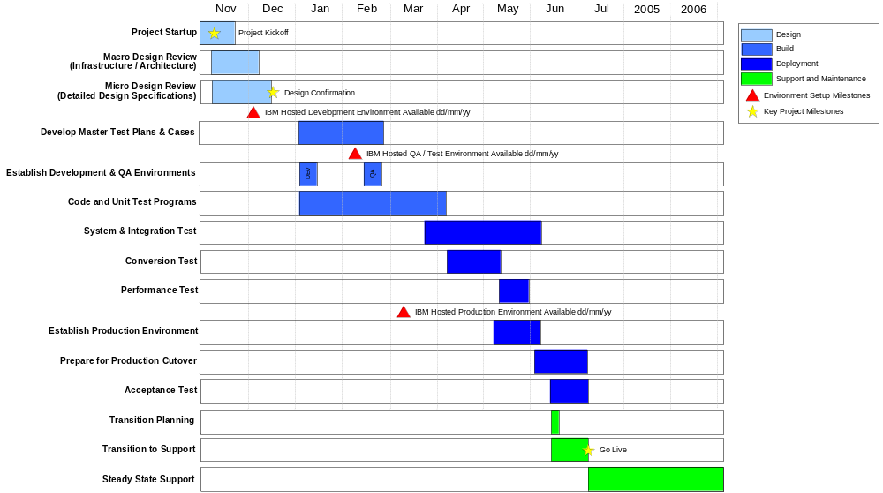
Project Timeline
IBM Approach

Slide 27
ODS and E.6 Implementation Team Structure
IBM Approach
Role | Description | Gap | IBM
Project Partner | The Project Partner has overall management oversight and responsibility for the customer project, services delivery, IBM staffing and customer satisfaction |  | ✓
Project Manager | Responsible for establishing the core team, coordinating responsibilities, setting team direction and providing day-to-day management for the project | ✓ | ✓
Data Modeler | Responsible for definition and validation of data architecture based on solution requirements, technical decisions and proven practices |  | ✓
DBA | Leads design and construction of the ODS and E.piphany data mart including aggregation, indexing, data distribution, data security and other data functions |  | ✓
ETL Specialist | These individuals are trained on leading data warehouse ETL tools and provide the technical knowledge for the ETL process. They work with the application specialist to understand the source and the database specialist to understand the target for load | ✓ | ✓
Operations App. Developer | A tool specialist familiar with monitor job scheduling through ESP Expresso for E.piphany relocation and legacy systems | ✓ | ✓
Application / Security Arch. | Application / Security Architect to design, develop, re-engineer complex application components, and integrate software packages, security, programs and reusable objects residing on multiple platforms |  | ✓
Solutions Architect | Responsible for definition and validation of the ODS and E.piphany Data Mart solution architecture based on business requirements, and technical decisions |  | ✓
E.piphany Subject Matter Expert | SMEs will review and validate the business requirements already captured and create a system design document that will be used for configuring the E.piphany tool and constructing the data mart |  | ✓
Client Subject Matter Experts | Business, IT, Gap production support subject matter experts to assist the IBM implementation team with the design confirmation and testing phases of the project | ✓
Testing Lead | Responsible for identifying and documenting system and user acceptance test plans and leading the execution and documentation of those plans |  | ✓
Trainer | The trainer will create a customized manual for the client for the business functionality of the solution and train resources on the score import process and job monitoring |  | ✓

Slide 28
Hosting and Support Team Structure
IBM Approach
Role | Description | Gap | IBM
Hosting Project Executive | Primary focal point for the hosting operations. Lead the translation of hosting requirements and is responsible for the formal agreements, plans, and technical team for delivery of the hosted environment. |  | ✓
Hosting Delivery Executive | The Hosting Delivery Executive responsible for the overall quality of service delivery and will work with the client team to understand your strategic business requirements and insure the appropriate service resources are available to achieve your objectives. |  | ✓
Hosting Transition manager | An experienced senior project manager responsible for building and executing deployment plans for IBM’s managed hosting solutions. The Transition Manager develops schedules and task lists that comprise the deployment plan |  | ✓
Hosting System Administrators | The System Administration team is responsible for implementing the fully managed server solution and performing system administration functions to build and support the hosted infrastructure environment |  | ✓
Hosting Database Administrator | Oracle / Trillium DBA. sets up file systems, ownership, permissions and sizes, Install software products per customer orders and assist with creation and setup database instances |  | ✓
ETL / UNIX / Batch Maintenance Admin | Responsible for implementing the solution and performing system administration functions to build and support the ODS / E.piphany hosting environment. |  | ✓
E.piphany / ETL Maintenance Admin | Responsible for implementing the solution and performing system administration functions to build and support the ODS / E.piphany hosting environment. |  | ✓
Post Implementation Technical Lead | Responsible the implementation and testing required for the ODS and the E.piphany data mart. This lead will provide leadership for ensuring that the environments represent production and is fully tested. This resource must have data acquisition, application structure and business knowledge of the source application. | ✓ | ✓

Slide 29
Staffing Plans for ODS and E.6 Implementation
IBM Approach
The staffing plan FTE requirements by role for both The Gap and IBM are presented below for the construction and implementation of the ODS and E.6 migration.
Resource | Nov 03 | Dec 03 | Jan 04 | Feb 04 | Mar 04 | Apr 04 | May 04 | Jun 04
Gap Resources
Project Manager | 1 | 1 | 1 | 1 | 1 | 1 | 1 | 1
ETL Specialists | 2 | 2 | 2 | 2 | 2 | 2 | 2 | 2
Operational Support Specialist | 1 | 1 | 1 | 1 | 1 | 1 | 1 | 1
Gap Subject Matter Experts | * | * | * | * | * | * | * | *
IBM Resources
Project Partner | 0.2 | 0.2 | 0.2 | 0.2 | 0.2 | 0.2 | 0.2 | 0.2
Project Manager | 1 | 1 | 1 | 1 | 1 | 1 | 1 | 1
Data Modeler | 1 | 1
DBA – Oracle | 1 | 1 | 1 | 1 | 1 | 1 | 1
DBA - Oracle/Trillium | 1 | 1 | 1 | 1 | 1 | 1 | 1 | 1
ETL Specialists | 3 | 4 | 5 | 5 | 5 | 5 | 3 | 2
Application developer- Unix shell scripts/ Tivoli |  | 1 | 1 | 1 | 1 | 1 | 1 | 0.5
App Arch/Security Arch | 1 | 1 | 1 | 1 | 1 | 1 | 0.5
Solution arch | 0.5 | 0.5 | 0.5 | 0.5 | 0.5 | 0.5 | 0.5
Epiphany Specialists | 2 | 3 | 3 | 3 | 3 | 1 | 1 | 0.5
Testing lead |  |  |  | 0.5 | 1 | 1 | 1 | 1
Trainer |  |  |  |  | 1 | 1 | 1
Total IBM Resources | 11 | 14 | 14 | 14 | 16 | 14 | 11 | 6
* Gap subject matter expert requirements to be determined based upon the detailed project plan
Listed in FTE’s

Slide 30
Staffing Plans for Support and Maintenance
IBM Approach
The staffing plan requirements for the steady state support and maintenance of the solution through December 2006 is listed below.
SUPPORT & MAINTENANCE RESOURCES
 | Jul 04 | Aug 04 | Sep 04 | Oct 04 | Nov 04 | Dec 04
Project Exec / DPE | * | * | * | * | * | *
DBA - Oracle/Trillium | 1 | 1 | 1 | 1 | 1 | 1
ETL / Unix / Batch Maintenance | 1 | 1 | 1 | 1 | 1 | 1
Epiphany / ETL Maintenance | 1 | 1 | 1 | 1 | 1 | 1
Post Implementation Tech lead | 1 | 1 | 1 | 1 | 1 | 1
System Administration* | * | * | * | * | * | *
Total IBM Resources | 4 | 4 | 4 | 4 | 4 | 4
Dec 06
*
1
1
1
1
*
4
* As part of the hosting arrangements, there will be system operations resources assigned and available to the Gap hosting operations for AIX administration, files systems support, network monitoring and other routine maintenance tasks.

Slide 31
The Gap Inc. E.piphany Relocation Discussion
Customer ODS Review and Discussion
Introductions, IBM’s Relevant Experience
Solution Overview
IBM Approach (Project Approach, Timeline)
Customer ODS Review and Discussion
E.piphany Review and Discussion
Hosting, Infrastructure and Support Review and Discussion
Wrap-Up and Q&A

Slide 32
ODS Design Considerations
Customer ODS Review and Discussion
Based on our prior experience with Customer ODS implementations, the following design considerations need to be evaluated to identify gaps and confirm the project scope
Review Input Staging Data from External and Internal Sources
Review Data Cleansing
Procedures
Review Core
Table Staging Process
Review
Data
Model
Review internal
and external
output
requirements

Slide 33
Review Input Data from External and Internal Sources
Customer ODS Review and Discussion
Goals
Develop an understanding of:
  source file granularity
  frequency of update (delta versus full update)
  relationship of each input file
  transformations required (if any) within the ODS
Assess table structures for speed in writing and speed in reading
Design Metadata input and process
Assumptions
Current source files must have data sufficient to maintain referential integrity within the ODS; if not, the Gap will need to make a decision on the “go forward” strategy, e.g. address issues with downstream systems or live with implications in the initial implementation.
Gap will assist IBM in identifying validation tests which will assess data quality of the input files

Slide 34
Review Data Cleansing Procedures (Customer Hygiene and De-duping)
Customer ODS Review and Discussion
Goals
Develop a process to:
  Hygiene customer name & address, customer email, phone number and define gender rules
  Determine the depth of automated rules, manual review and exception reporting
  Encrypt and de-encrypt GE Credit data and credit card numbers during hygiene and load
  Determine the depth of automated de-dup rules, manual review and exception reporting for customers
Assumptions
Gap will share with IBM hygiene and de-dup processes currently used and will provide input of comfort levels (x%) and extent of manual processing to be used. Data abnormalities requiring fixes will be corrected in the source systems by the Gap.

Slide 35
Review Staging Process to Core Table
Customer ODS Review and Discussion
Goals
Develop a process for:
  validating the core data model against business requirements
  mapping all core table data elements to input files
  establishing the table relationship rules to ensure referential integrity
  designing the validation scripts required to confirm data quality
Establish Service Level requirements for ODS loads
Assumptions
All data required for this application are housed in the six input sources provided in the design (B2B, Brand IT, Gap HR, EDW, E.piphany and SAS) and are at the appropriate granularity to ensure data integrity
Unique identifiers are available and can be used for building relationships (keys)
History and slowly changing dimensions are available as required by the business
The Gap will provide clear-cut rules for validating data for the application

Slide 36
Review Internal and External Output Process
Customer ODS Review and Discussion
Goals
Develop an understanding of:
  file granularity required for output systems, e.g. EDW, SAS, E.piphany, and B2B Server
  frequency of output
Confirm outbound table structure
Design Metadata processes required from ODS to output files
Assumptions
IBM will “push” files/tables for the four systems as validated during the design confirmation. The Gap will be responsible for “picking up” these files via the four systems.

Slide 37
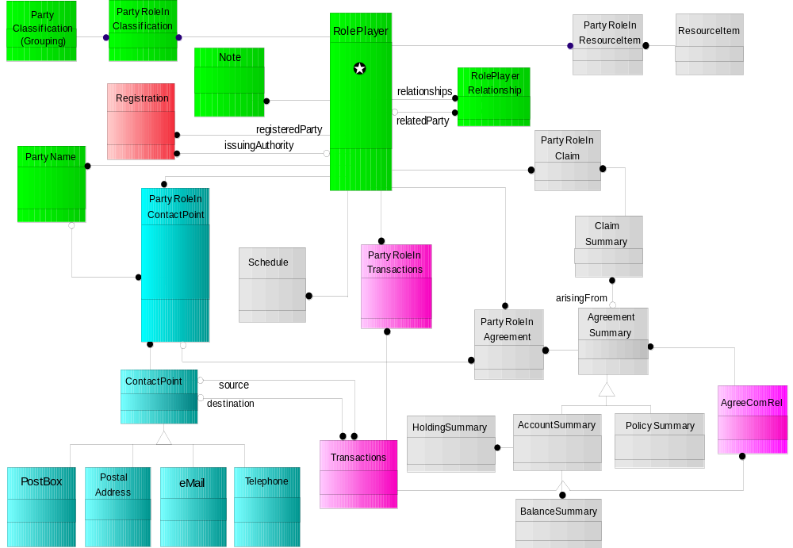
ODS Data Model Review
Customer ODS Review and Discussion
IBM will leverage existing Retail / CRM intellectual capital assets to confirm the current Gap customer data model design
Present “one face” to the customer
Support multiple roles per individual customer
Support different customer definitions including: business, government and consumer
Support definition of roles such as consumer, buyer, sales agent, receiving agent and dimensional categorization
Identify relationships among customers
Classify and track customer interactions (i.e. purchases, ship/receives, direct mail, etc.)

Slide 38
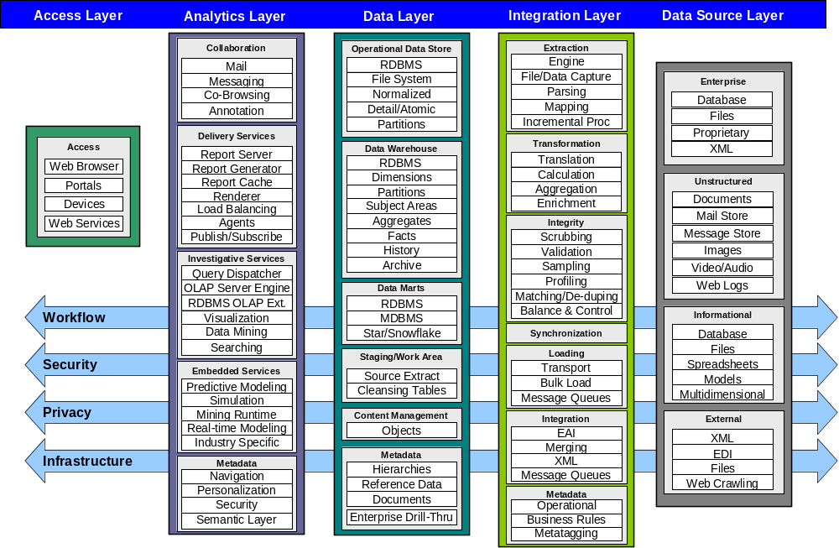
Business Intelligence Technical Reference Architecture

Slide 39
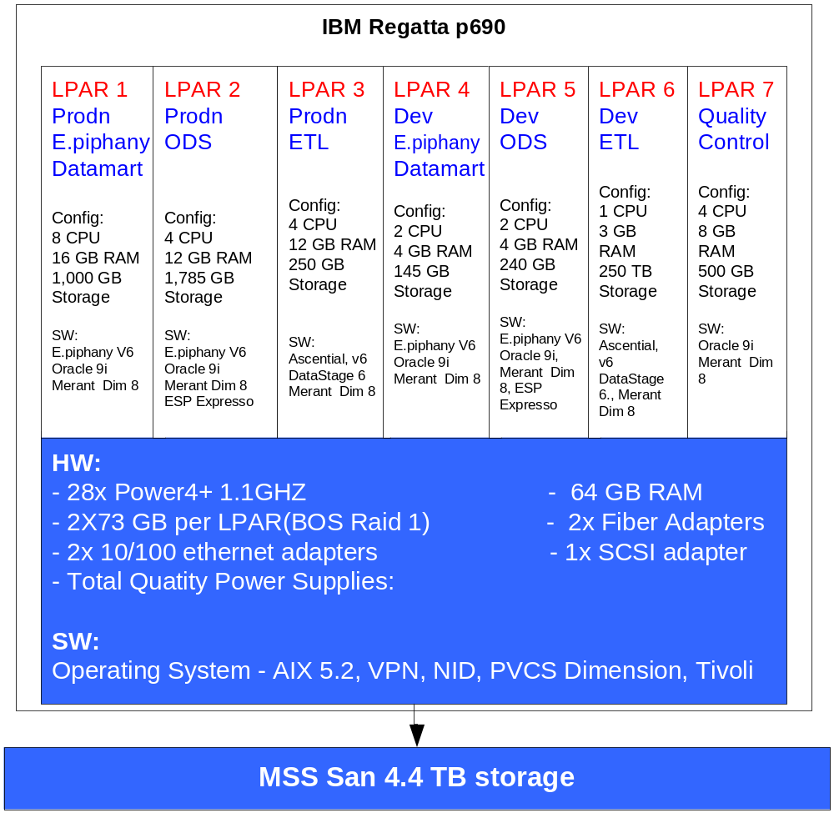
Physical ODS / E.piphany Data Mart Implementation
Customer ODS Review and Discussion

Slide 40
The Gap Inc. E.piphany Relocation Discussion
E.piphany Review and Discussion
Introductions, IBM’s Relevant Experience
Solution Overview
IBM Approach (Project Approach, Timeline)
Customer ODS Review and Discussion
E.piphany Review and Discussion
Hosting, Infrastructure and Support Review and Discussion
Wrap-Up and Q&A

Slide 41
E.piphany Implementation Discussion
E.piphany Review and Discussion
The remaining key steps for the E.piphany application:
Development
  Incremental load development
  Campaign backfeed jobs
  Output file configuration and automation (if needed)
  Configure E.piphany productivity tools for end users (business rules, treatment strategies)
Testing
  E.piphany Data validation – Focus on validation from ODS to E.6 Data Mart
  Performance Tuning and Optimization
  Full load testing
  Incremental load testing
  Integration testing with ODS
  User Acceptance Testing
    .

Slide 42
Development
E.piphany Review and Discussion
Development involves finalizing the following:
User Interface
  Incorporate concept model and design feedback into the application
  Assist users in defining and configuring some campaign build productivity features, e.g. business rules, treatment strategies, permission rules
  Finalize user access to data (security)
  Configure output files for main mail houses or other destinations
Complete ETL and Load Jobs
  Complete initial load jobs
  Incremental load job development and unit testing
  Campaign backfeed jobs to backfeed campaign data from EpiOp
  Unit test all jobs

Slide 43
Testing
E.piphany Review and Discussion
Testing starts early in the development process.
The following risk factors may be encountered during the test phase:
  Insufficient staff to perform testing
  Underestimating the time required to perform testing
  Inadequate test data
  Poor test results analysis
  Software complexity
To mitigate these risks, testing should:
  Use full sets of production data
  Allow for time to go through multiple passes of testing cycles
  Involve end users
  Validate every attribute and measure for accuracy
  Follow a detailed test plan and scripts

Slide 44
Best Practices for Performance Optimization
E.piphany Review and Discussion
There are multiple levels of performance optimization addressed during the remaining phases of the project.
Hardware
& Disk Subsystem
# of spindles/# of disks
# of fiber channel between disk subsystem and database server
Subsystem capabilities – such as cache, processors
RAID Options
Disk Striping
Database
Extent sizing
Parallelism approach - Parallel automatic tuning or not
Memory allocation and management
Design optimized for performance, e.g. dimension and fact sizing and structure, thin fact tables, etc.
ETL Optimization – SQL Tuning
Semantics review and configuration
Aggregates
Using “Thin” tables
Indexing Strategy
E.piphany
Application
E.piphany Users
End User Training on Best Practices in Campaign Structure, e.g. most restrictive filter first, least number of filters
Run lists and reports in the background

Slide 45
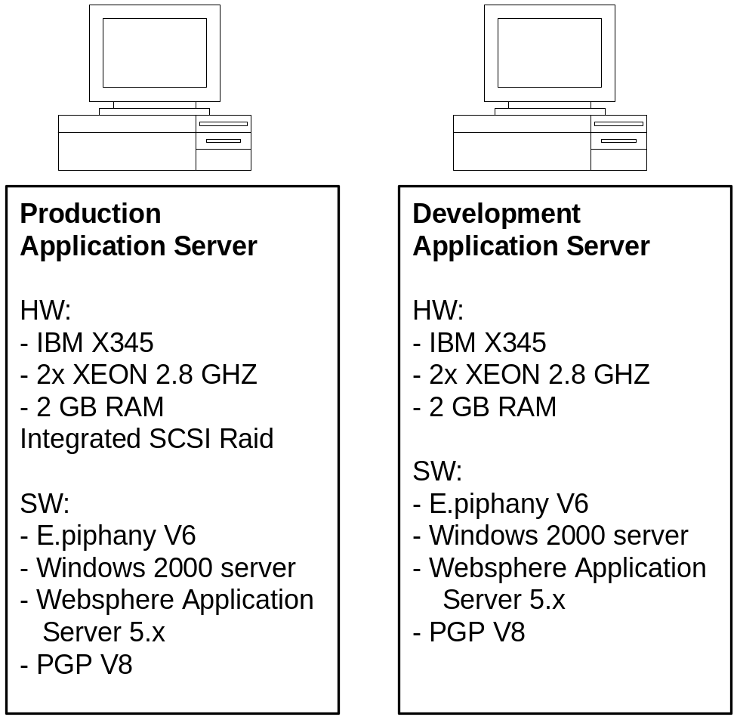
Physical E.piphany Implementation
E.piphany Review and Discussion

Slide 46
The Gap Inc. E.piphany Relocation Discussion
Hosting, Infrastructure and Support Review and Discussion
Introductions, IBM’s Relevant Experience
Solution Overview
IBM Approach (Project Approach, Timeline)
Customer ODS Review and Discussion
E.piphany Review and Discussion
Hosting, Infrastructure and Support Review and Discussion
Wrap-Up and Q&A

Slide 47
The Services and Hosting Market Evolution
Hosting, Infrastructure and Support Review and Discussion
On Demand Services
FLEXIBLE HOSTING, MODULAR APPS
Transformational Services
NEW INDUSTRY FOCUS…CREATION OF BCS
e-business Services
E-COMMERCE, GLOBAL COLLABORATION, NEW BUSINESS APPS, MOBILE
Traditional Data Center
SERVER & SOFTWARE OPERATIONS, DISTRIBUTED SERVICES, CRITICAL BUSINESS APPS
1996
1998
2000
2002
2004
2006
Notes:
Services have changed over the years, adapting to market trends and needs...first with client server computing, then network computing, now with the Internet.
Doing business over the Internet calls for different services...not always traditional outsourcing
e-sourcing represents the next wave of IT services.
Hosting and utility computing are coming into play more and more...do it for me, but do it in a standard format so I can communicate/do business with others
With the Internet, outsourcing morphed and took on a new shape/form -- e-business services. And while this was happening, new technologies were developed and needed to be integrated into our strategy, such as pervasive computing, Linux, wireless
Meanwhile, technology continues to advance toward a more intelligent infrastructure - GRID computing, eLiza and autonomic computing
Technologies that are more intelligent, that can identify problems and "heal" themselves
Grid computing - extends computing capabilities to the Internet
Services are again moving and changing with the market needs.
e-sourcing represents the newest computing model and IBM Global Services is moving in that direction as well
Background on transformational outsourcing:
The most recent trend in IT services was called transformational outsourcing. It was a logical step forward in the e-business adoption.
With transformational outsourcing, companies embraced e-business throughout their organizations in order to transform their business processes.
Transformational outsourcing moved us (IBM) beyond simply taking over existing IT functions (traditional outsourcing), and into the area of helping customers build entirely new ways of operating.
Transformational outsourcing wasn't just another way to cut IT costs. It was about aligning IT resources for maximum business value.
Transformational outsourcing created a broader view of outsourcing because it takes into account both present and future requirements.
Now, the next iteration of services takes transformational outsourcing a step further. Companies have made major infrastructure investments. How can keep up with the pace of technology and take advantage of their infrastructure -- without major investment -- but still be out ahead of their competitors?

Slide 48
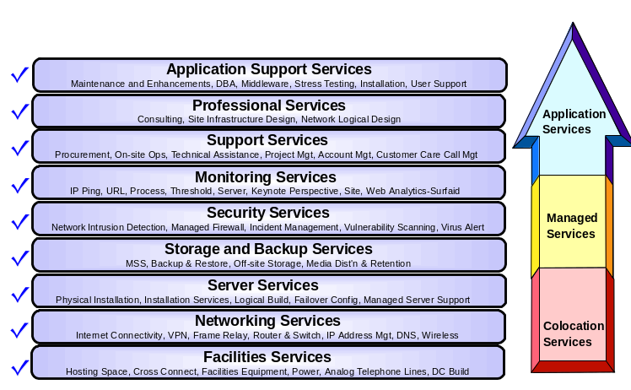
Flexible Delivery Service Offerings
Hosting, Infrastructure and Support Review and Discussion
Proposed
Solution
For The Gap

Slide 49





Dedicated and Virtual Infrastructure Options
Hosting, Infrastructure and Support Review and Discussion
Potential Option
For Expansion
Proposed Solution
For The Gap
Virtual server hosting services
Internet
Dedicated server hosting services
Customer A
Dedicated hosting environment
Customer X
virtual xSeries
Customer B
Customer C
Dedicated
Infrastructure
and
Management
Services
Customer D
Virtual Server Networking Services
Dedicated hosting environment
Customer Y
virtual zSeries
Customer E
Customer F
Customer G
Universal Management Infrastructure
IBM Management Toolset
Dedicated hosting environment
Customer Z
virtual pSeries
Customer H
Customer I
Boulder Delivery Center
End-to-end utility solution
End-to-end dedicated environment
Blended environment of virtual and dedicated servers and services
Notes:
IBM has designed a DC → ODCS
IBM has leveraged an ESM approach to UMI and providing flexibility.

Slide 50
Our Current Understanding
Hosting, Infrastructure and Support Review and Discussion
The Development, Test and Production environments will be hosted by IBM and IBM will provide on going production support for a two - three year period.
The infrastructure will be provided and managed by IBM in an IBM Data Center
A dual site geographic load balanced solution is not required
High availability clustering is not required for servers
High availability networking infrastructure is required for network service levels
IBM can use its standard monitoring and management processes and tool sets
VPN and Internet connectivity is sufficient for networking requirements
Online data backup and restore is required
Gap is providing some SW licenses it already has or will have
Gap plans to move the environment in house in 2006
Gap has an end user help desk that will route authorized calls to IBM’s level 2 support structure

Slide 51
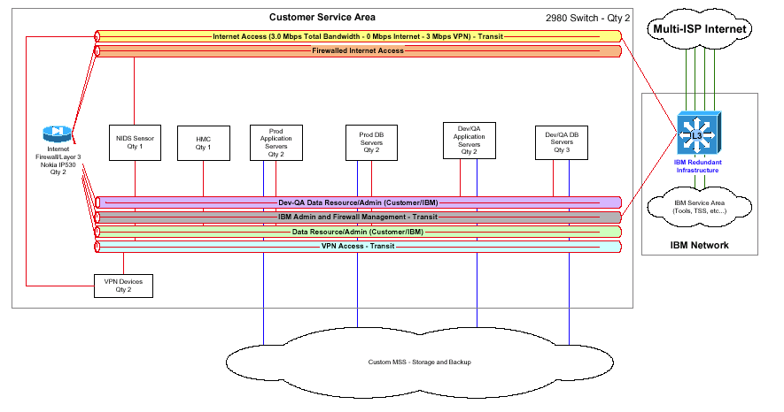
Network Infrastructure
Hosting, Infrastructure and Support Review and Discussion

Slide 52
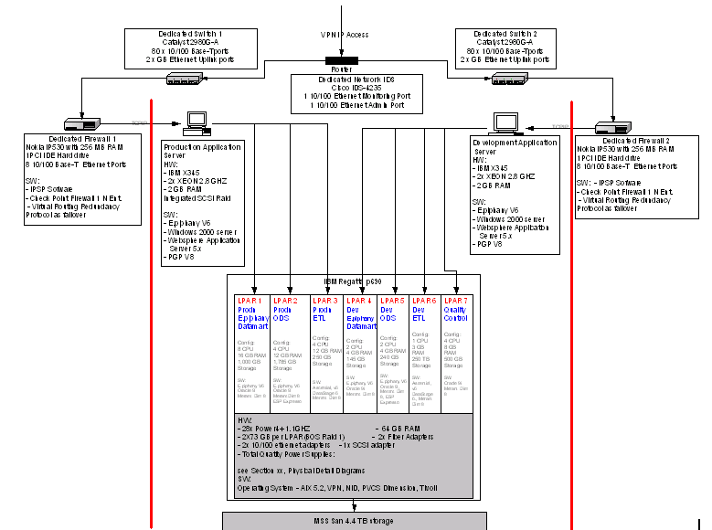
Proposed Physical Architecture
Hosting, Infrastructure and Support Review and Discussion

Slide 53

Storage Configurations
Hosting, Infrastructure and Support Review and Discussion
FAStT 700 Storage Server | 84 x 73.4 GB/15K Disk Modules 2 x FAStT 2 Gbps Mini Hubs 18 x short wave SFP
IBM Ultrascalable Tape Library 3584-L32 | 12 x LTO Ultrium 2 Fibre Drive 20 x Additional LTO I/O Slots 1 x Controll Path Failover 1 x Fibre Channel patch Panel
TSM Server | IBM pSeries 630 2 x 2-WAY 1.45GHZ PWR4+ 2 x 2048MB DIMMS 2 x 36.4 GB 10K RPM U3 SCSI DDA 2 x 146.8GB 10K RPM U3 SCSI DDRASS 2 x 2 GIGAB FIBRE CHANN PCI-X ADPT 1 x 4 Port 10/100 Ethernet

Slide 54
Software
Hosting, Infrastructure and Support Review and Discussion
Provided by IBM | Provided by The Gap
AIX 5.2 Operating System Windows 2000 Server Operating System Tivoli Storage Manager Tivoli Data Protection Merant Dimensions v8 Ascential DataStage Enterprise Edition PGP v8 BMC Patrol Server Resource Manager | Trillium Oracle 9i E.piphany Mercury WebSphere Business Integration Server ESP Espresso

Slide 55
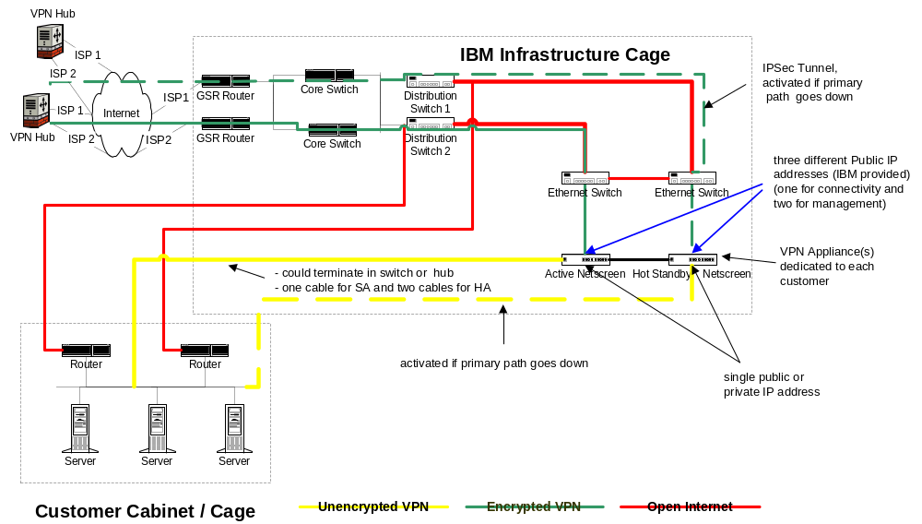
Hosting, Infrastructure and Support Review and Discussion
High Availability VPN configuration

Slide 56

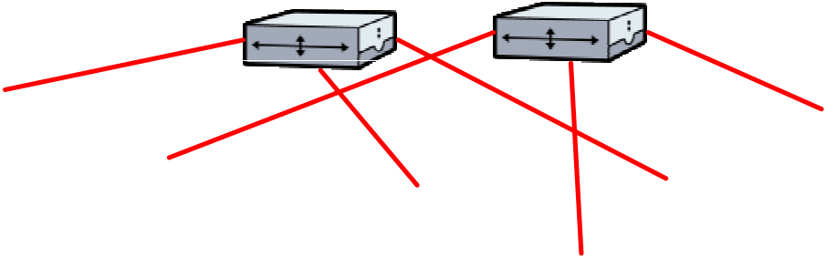
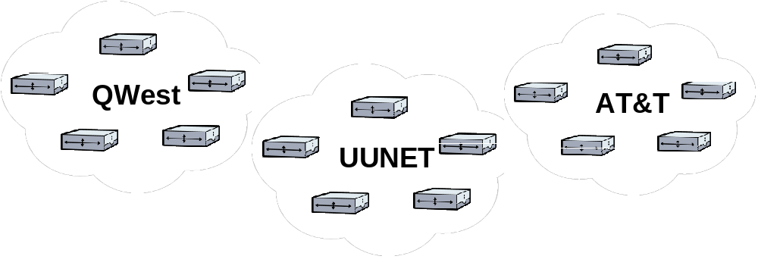

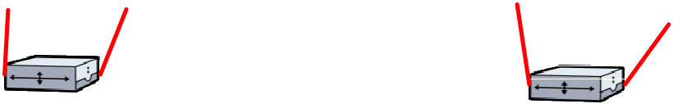
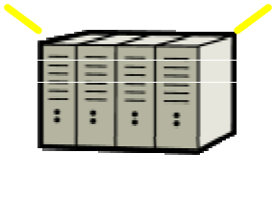
Hosting, Infrastructure and Support Review and Discussion
Multiple-ISP Architecture
Components
Up to OC 192 Capacity (with Gig E handoff to Customer)
Self-healing SONET rings with diverse routes and POPs
Multiple Internet Service Providers
Diverse connection points into IBM
Advantages
High Availability
Performance
Service Levels

Slide 57
Hosting, Infrastructure and Support Review and Discussion
Management Tools
  Tool Purpose
  Tivoli/BMC - Framework for Event Console – rule base event handler/collator
  NetView/MLM - SNMP poller/receiver, Device availability (ping)
  PCPMM - Port Connect Pattern Matching Monitoring - URL poller
  Syslog - System logger function for server/network devices
  SRM - Server Resource Management - Collects data 24x7
  Database, server, FTPs logs and create web reports
  Hosting Connection Portal - Online access to alerts / reports
  NodeWatch Notify - Email alerts to Gap if desired

Slide 58
Security Services
Hosting, Infrastructure and Support Review and Discussion
Included in Proposal
  Anti-Virus Services
  Network-based Intrusion Detection
  TCP/IP Vulnerability Scanning
Other Available Services
  Security Advisory Services
  Host-based Intrusion Detection
  Security Validation and Compliance Checking
  Vulnerability Assessment Testing
  Incident Management
  Information Security Advisor (ISA)
  Issue Tracking

Slide 59
Application Management Services: Overview
The IBM Application Management Services team will provide on-going Application Support, Maintenance and Small Enhancements.

Slide 60
Our steady state model provides for clear lines of communication with well defined roles and responsibilities for project delivery.
Hosting, Infrastructure and Support Review and Discussion
Application Management Services Team Structure
Communication
Strategic Direction
End-user Interface
Program Management
Requirements Specification
User Acceptance Testing
Governance
GAP
LOCAL IBM TEAM
Technical Manager
Primary Client Interface
Project Management
Business Direction
Subject Matter Expert
Requirements Analysis
Planning & Estimating
External/High Level Design
Integration Testing, Acceptance Testing Support
Defect support
Communication
INDIA
IBM TEAM
Technical Resources (ETL, E.piphany, Oracle)
Internal/Low Level Design
Programming & Unit Testing
Production Support
Defect support
Process
Methods
Tools
Consistent Practices, Subject Matter Expertise, Lessons Learned
This structure gives GAP the convenience of having local points of contact, with the cost advantages of offshore resources.

Slide 61
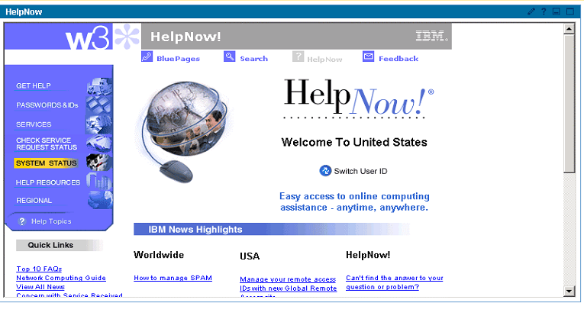
IBM will work with Gap to integrate Level 2 and Level 3 Support into the overall Gap Call Center/Help Desk process.
Hosting, Infrastructure and Support Review and Discussion
Application Management Services Support Structure
24 X 7 Support Structure
Level 1
Level 2
Level 3
IBM
Onsite/
Offsite Team
IBM
Onsite/
Offsite Team
GAP
Help
Desk
User related problem resolution
Problem Analysis,
Problem resolution
as appropriate,
Severity Level
Assignments in
conjunction with
SPE
Problem
Resolution

Slide 62
Hosting, Infrastructure and Support Review and Discussion
IBM e-business Hosting Connection
Visibility to IBM e-business Hosting environment through a personalized/secure Web-based interface
Access to IBM HelpNow! Ticket/Request creation and status
View billing information
Access reports (e.g., Server Resource Manager, Performance, Monitoring Status, etc.)
Receive news and information on IBM's service offerings
http://www.ibm.com/services/myhosting

Slide 63
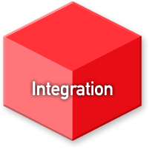
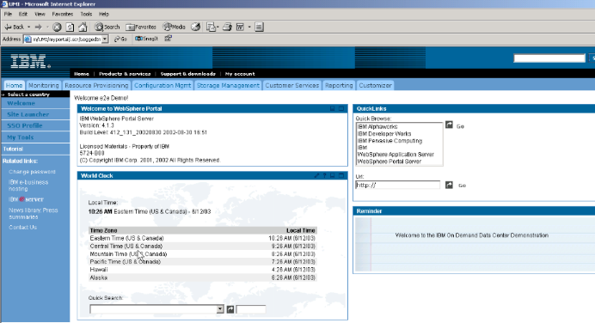
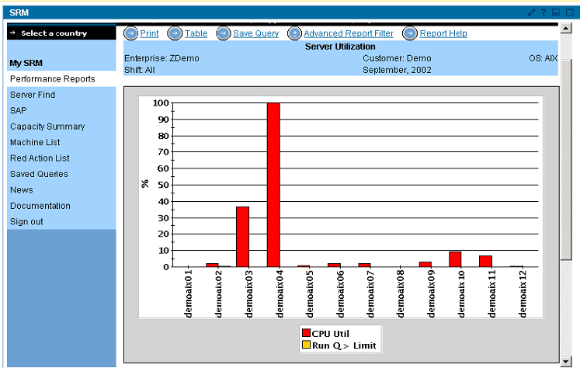
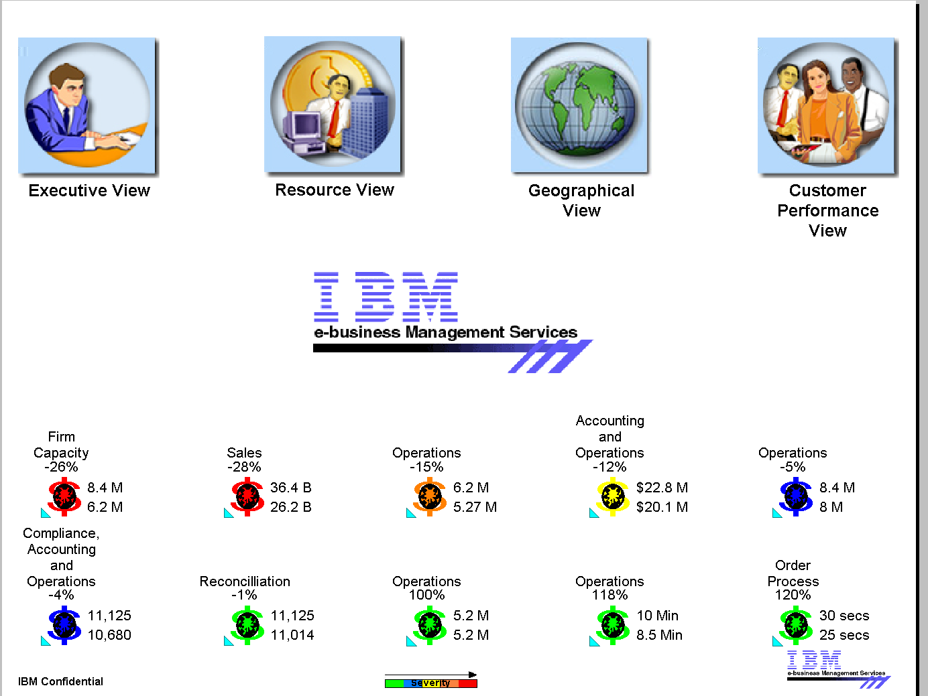
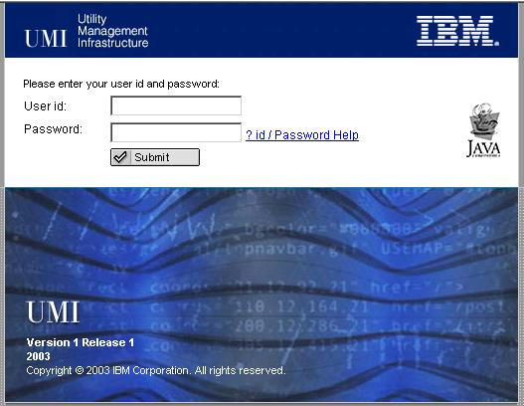
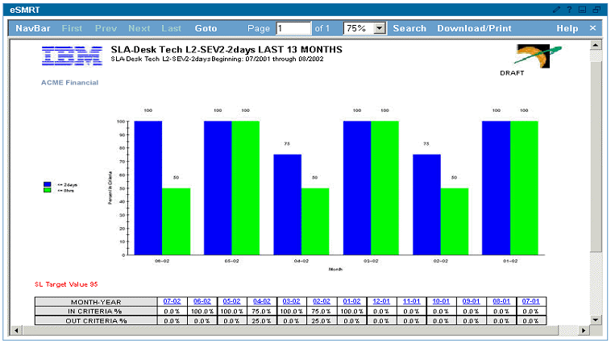
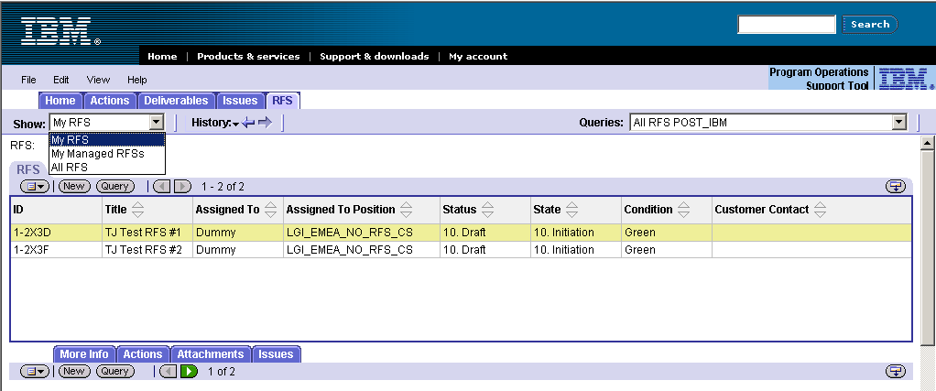
IBM e-business Hosting Connection
Hosting, Infrastructure and Support Review and Discussion
UMI visualization provides a customer facing web portal to monitor Enterprise Operational Processes and Program Management Processes
…
EOPs
Provi-sioning
Performance Mgmt
Availability Mgmt
Asset
Mgmt
Problem/ Change
Request for Service
Program Issues Mgmt
Customer Satisfaction Mgmt
Customer Comm. Mgmt
…
PMP
Enterprise Operational Processes
Program Management Processes

Slide 64
IBM’s Problem Management Approach is focused on a close looped problem management process to insure root cause identification and problem prevention.
Hosting, Infrastructure and Support Review and Discussion
IBM’s Problem Management Approach
New Ticket
Problem
Enhancement
Yes
Estimate
Created
Analyzed
Yes
SLA
NO
GAP and / or IBM
GAP
Technical
PM
Solution
Yes
Close
Ticket
Found in KB
Closed
GAP
No
No
Assign to a
Queue
Application
Team
Developer
Assign to a
Yes
Yes
Transition
Specific
Report
Person
Application
Developer
Severity 1
NO
Resolved
Solution
Defect?
No
EOD?
Implementation
Application
Developer
YES
Yes
NO

Slide 65
IBM will tie on-going reporting to performance
Hosting, Infrastructure and Support Review and Discussion
Delivering Quality of Service
Scorecard
Financial
Customer/Client
Development
Innovation
Infrastructure
Measures
/User Measures
Process
and Growth
On Budget Delivery/
Client Satisfaction Survey
Work Output Productivity
Maturity
Trans. Avail E2E
Project Estimation
Assessment (SEI/CMM)
Cycle Time /
Network Availability
On Time Delivery/
Customer Satisfaction
Incident Handling
Process Compliance
Project Estimation
Survey
Network Latency
Defect Rate / Adherence
to Specifications
Ave. Packet Loss
Service Requests
Milestone Completion

Slide 66
The Gap Inc. E.piphany Relocation Discussion
Wrap-Up and Q&A
Introductions, IBM’s Relevant Experience
Solution Overview
IBM Approach (Project Approach, Timeline)
Customer ODS Review and Discussion
E.piphany Review and Discussion
Hosting, Infrastructure and Support Review and Discussion
Wrap-Up and Q&A

Slide 67
Pricing
Wrap-Up and Q&A
Environment | Month Charge Incurred | One Time Charge | Monthly Recurring Charge
Software Charges | Month 1 | $411,755
Phase I – Environment Set Up | Month 1 | $302,545
Phase I – Environment Monthly Support | Month 1- 36 |  | $128,280
Production Environment Set Up | Month 5 | $ 26,350
Production Environment Monthly Support | Month 7 – 36 |  | $ 11,160
Totals |  | $740,650 | $139,440
Application Management Totals | Months 9 -36 |  | $ 44,506
Implementation Services:
Customer ODS $1,832,320
E.piphany Implementation $1,045,040
For discussion purposes only

Slide 68
Price Reduction Options
Leverage a smaller p-Series server if capacity and performance requirements can be met or adjusted
Reuse a Gap owned p650 server for the Tivoli Storage Manager environment
Phase in storage resource requirements… e.g. grow to 4.3 TB
Leverage a shared IBM On Demand p-Series virtual environment vs. a dedicated hosting solution
Leverage Gap’s licensing for 3rd party ISV software
Capped Services – The Gap’s requirement for fixed pricing for the hosting services are currently priced as an uncapped service. Although IBM currently offers our customer capped services for a specified number of hours per server, there is a potential for incremental charges to the GAP
Remove infrastructure redundancy (switches and firewalls) – this change would increase Gap’s exposure to downtime due to an network infrastructure failure
Share Production Support Resources and infrastructure between GMS and E.piphany Projects.

Slide 69
Why IBM
Single point of integration
  Minimizes risk
  Provides The Gap with one point of contact for:
    issue resolution and accountability
    management of relationship with alliances
Experience with large complex environments
  Designed and implemented some of the world’s largest and most complex business intelligence solutions
  Deliver the solutions leveraging the multiple capabilities across IBM
Provider of “World Class” infrastructure and technology
  Innovative hosting and sourcing solutions
  Unique combination of skills and resources
  State-of-the-art data centers
  Aggressive leadership and ongoing innovations in technology that set the pace in the industry

